Slide 1
Final project presentation
ODEs on Cosmological and Solar System Scales
Lee. Seung Min, Joo. Dae Young, Park. Jae Woong, Kim. Hyung Soo, Choi. Su Hwan

Slide 2
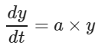
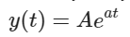
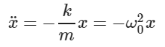
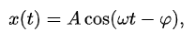
Ordinary differential equation (ODE)

Slide 3
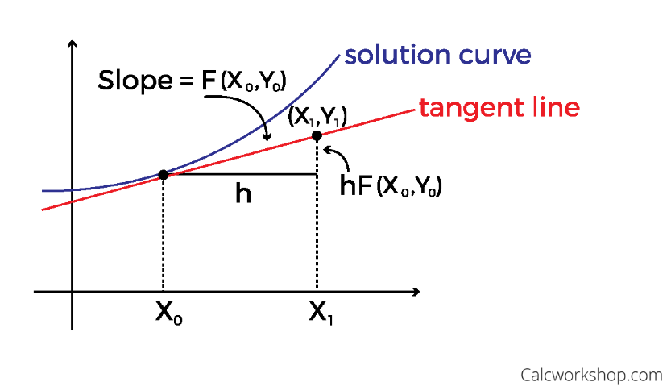
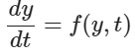
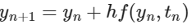
Euler Method

Slide 4
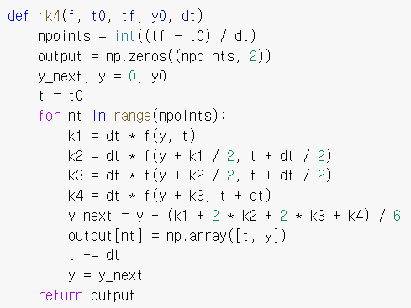
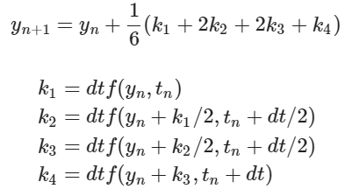
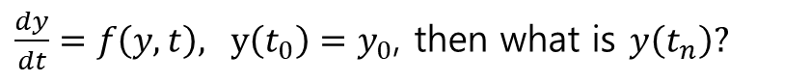
Runge Kutta Integrator
$\frac{dy}{dt}=f\left(y,t\right), y\left(t_{0}\right)=y_{0}$, then what is $y\left(t_{n}\right)?$

Slide 5
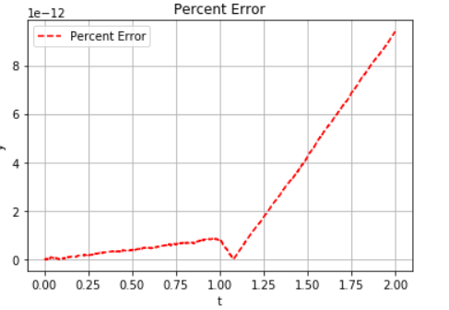
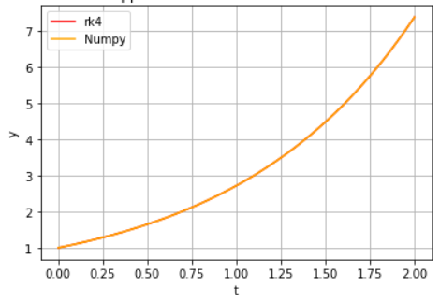
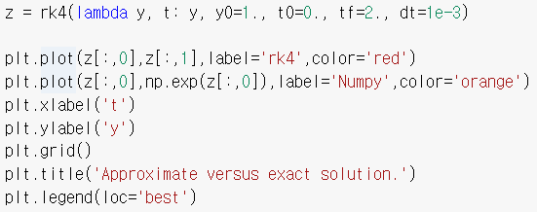

Runge Kutta Integrator
Solving $\frac{dy}{dt}=y$, $y\left(0\right)=1$

Slide 6
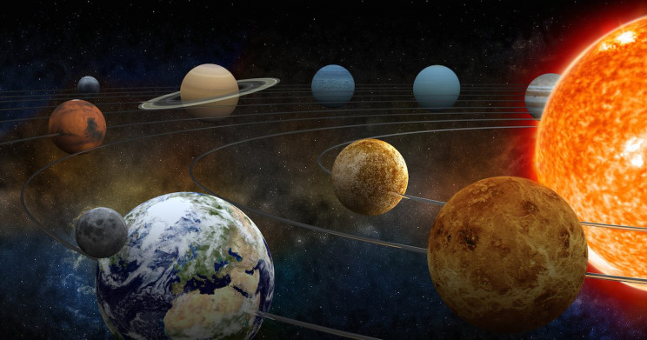
ODEs on Solar System Scales

Slide 7

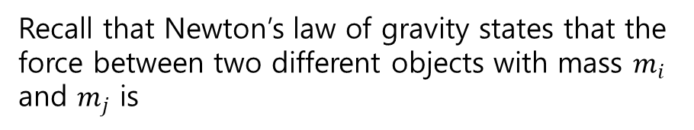
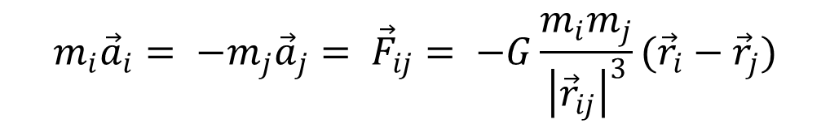
Equations of Motion
Recall that Newton’s law of gravity states that the force between two different objects with mass $m_{i}$ and $m_{j}$ is
$$m_{i}{\vec{a}}_{i}= −m_{j}{\vec{a}}_{j}= {\vec{F}}_{ij}= −G\frac{m_{i}m_{j}}{{\left|{\vec{r}}_{ij}\right|}^{3}}({\vec{r}}_{i}−{\vec{r}}_{j})$$

Slide 8
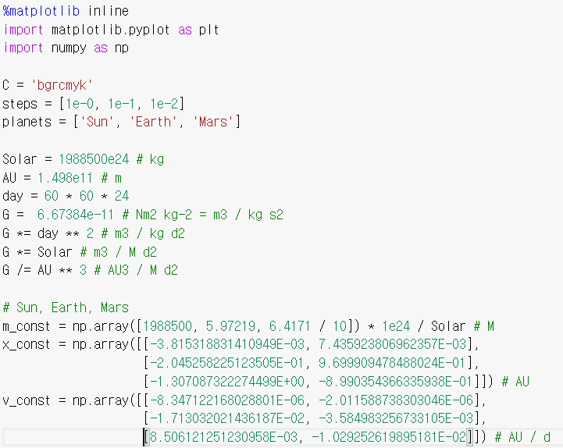
Simulating the sun, earth and mars with 2d N-body solver
Units
Distance: AU
Mass: M ☉
Time: day

Slide 9
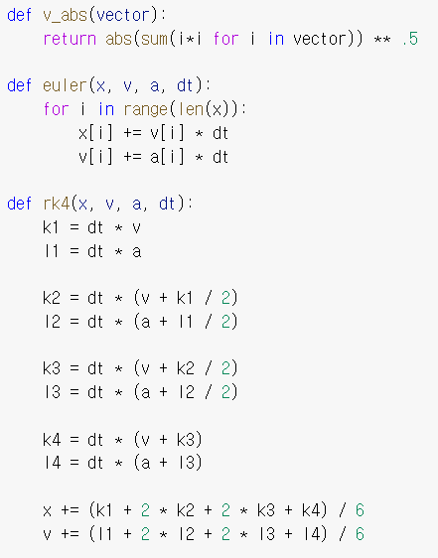
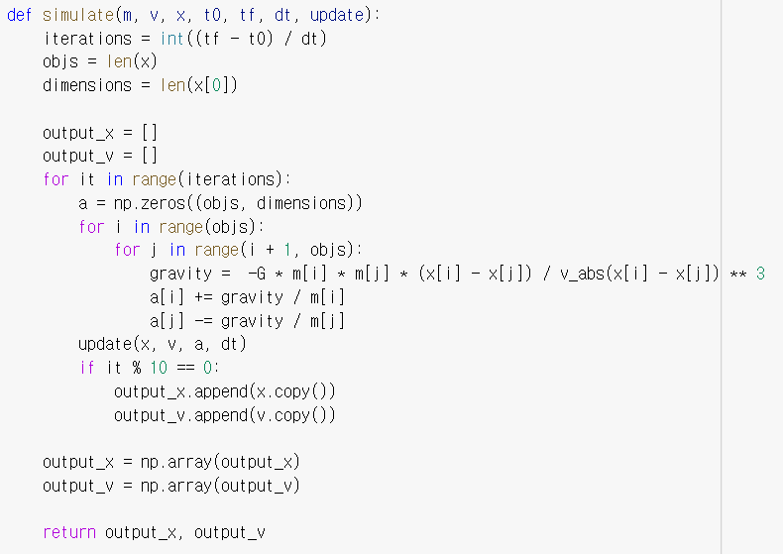
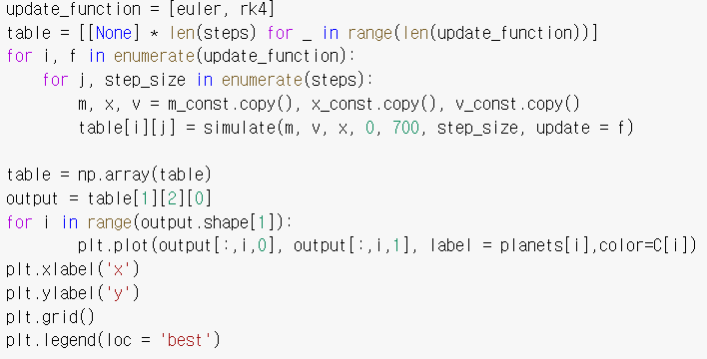
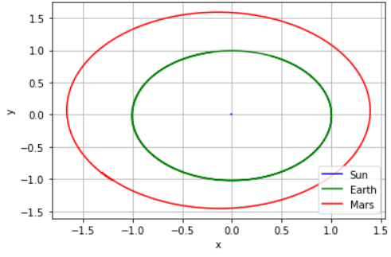
Simulating the sun, earth and mars with 2d N-body solver

Slide 10
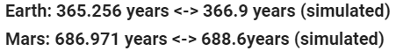
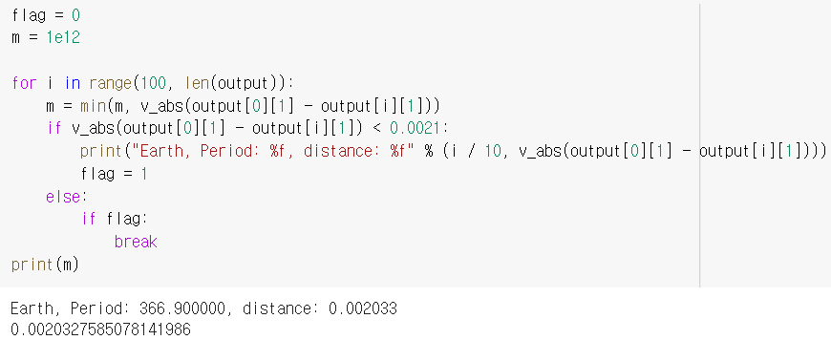
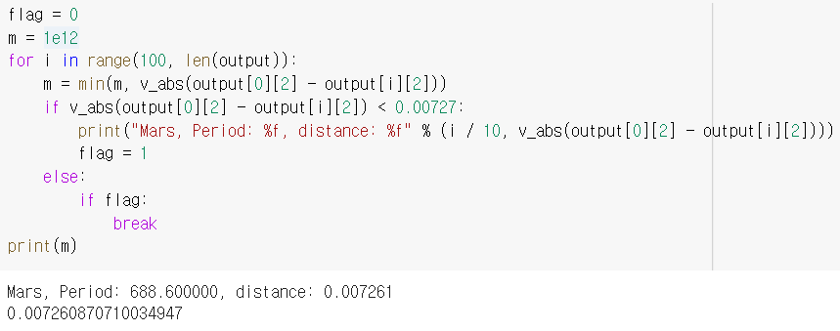
Verifying our solver
Verify our solver by checking the time it take for the Earth & Mars to go around the sun
Earth
Mars

Slide 11
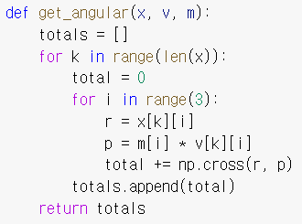
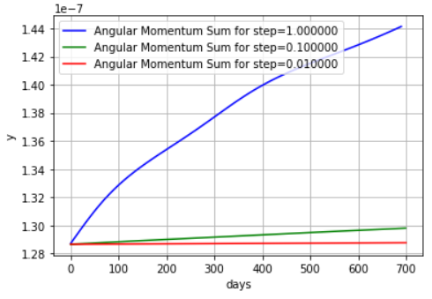
Angular momentum conservation

Slide 12
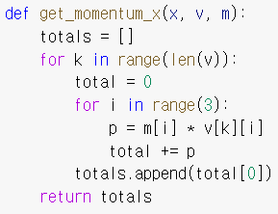
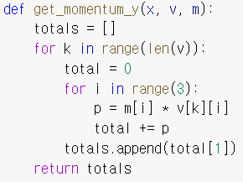
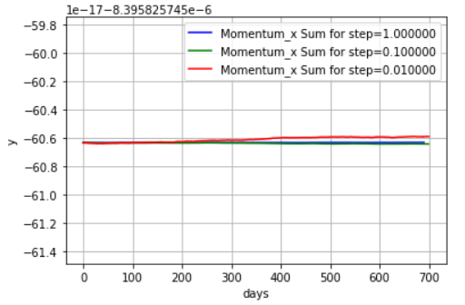
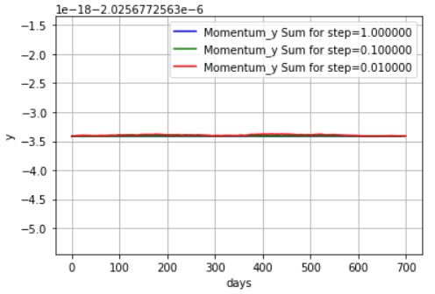
Momentum conservation

Slide 13
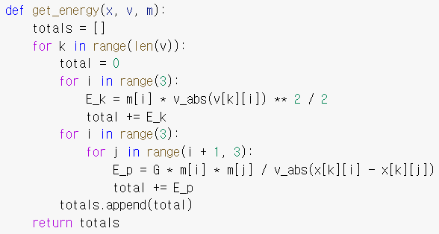
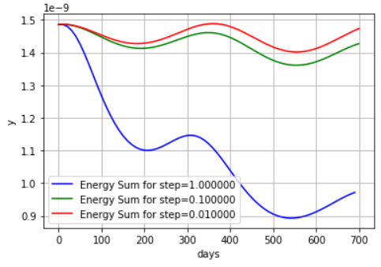
Energy conservation

Slide 14
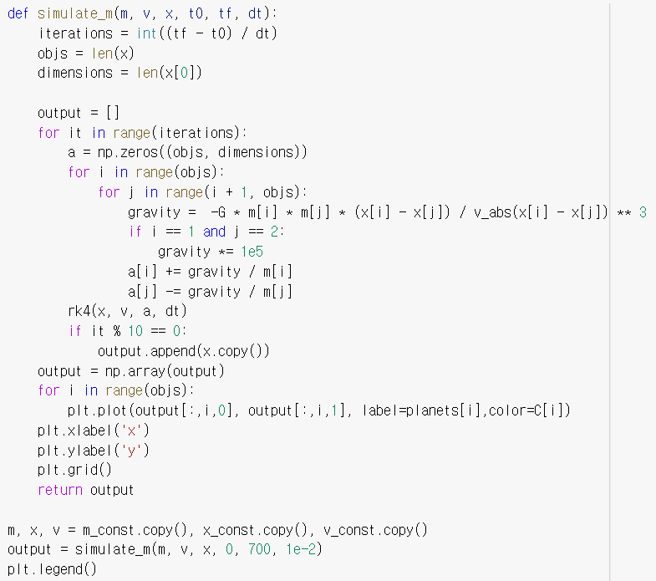
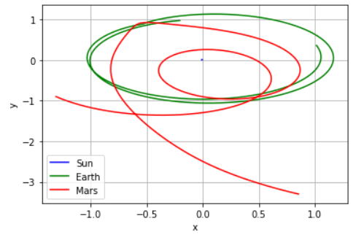
Increasing the gravitational interaction
What happens when you increase the gravitational interaction between earth and mars by a factor of 100,000?

Slide 15
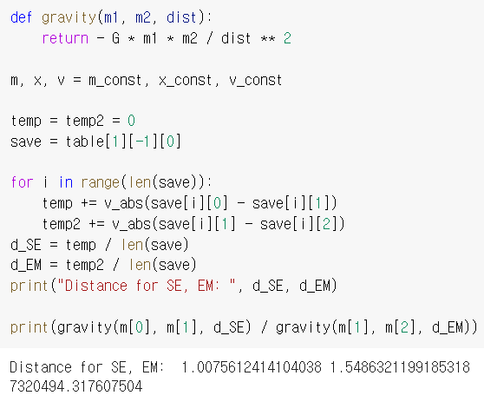
Increasing the gravitational interaction
How much should the interaction rate be increase for the force of mars to be roughly equal to the sun?

Slide 16
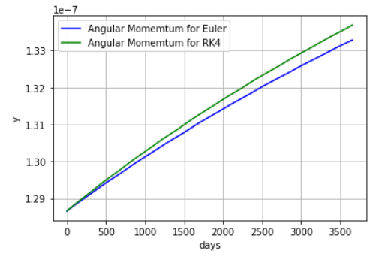
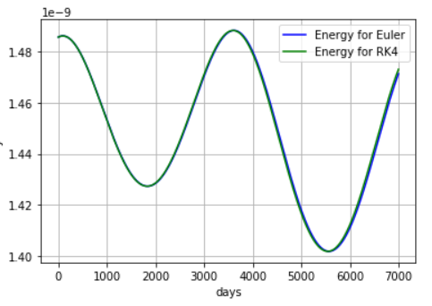
Euler vs RK4

Slide 17
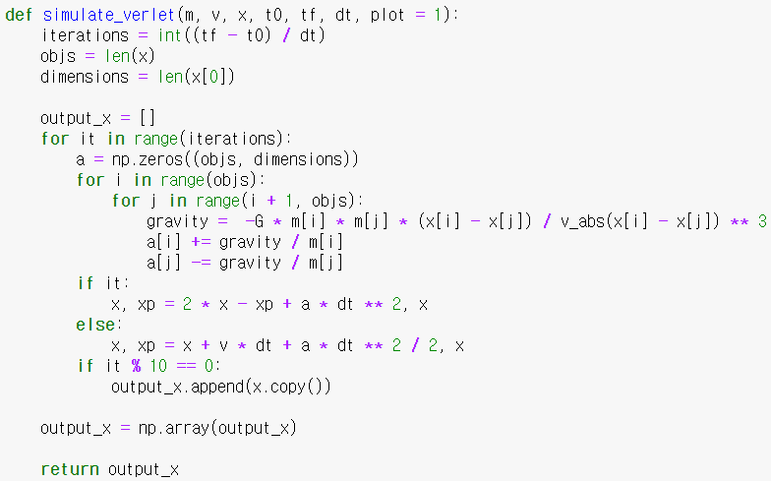
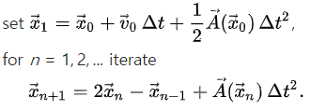
Verlet Integration

Slide 18
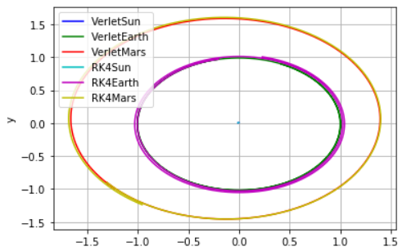
Verlet Integration

Slide 19
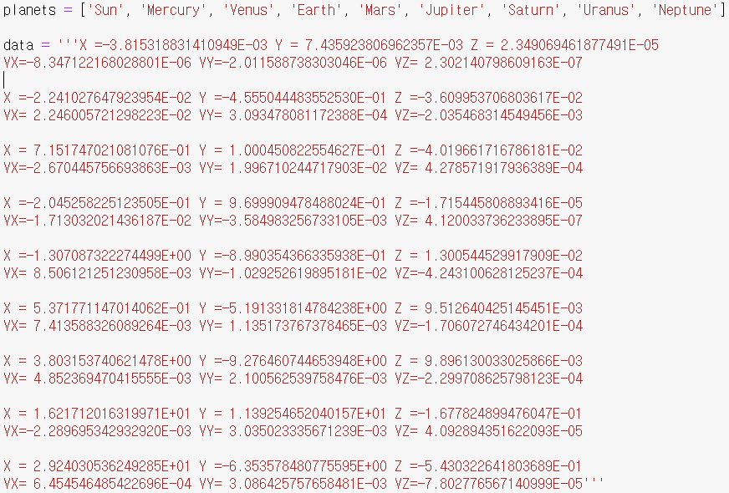
8 Planets

Slide 20
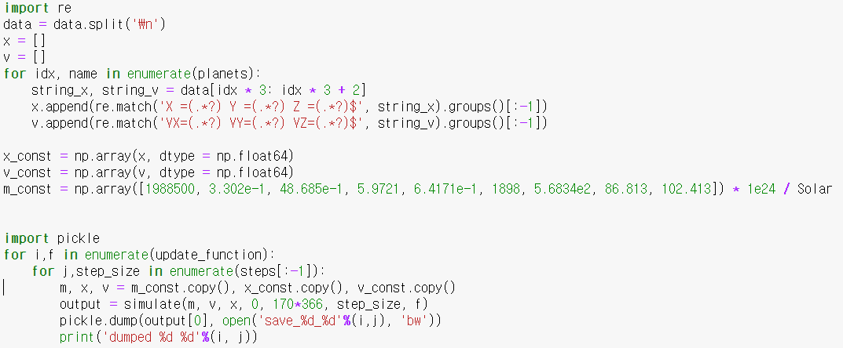
8 Planets

Slide 21
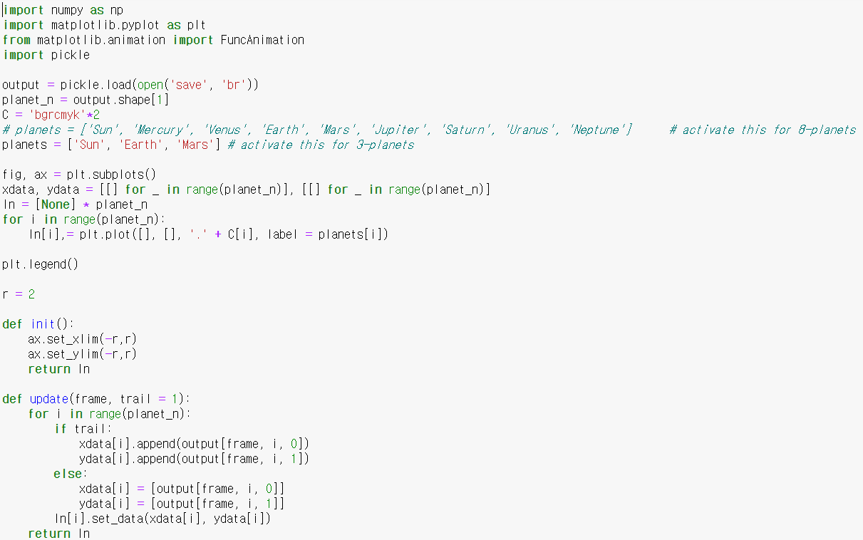
Animated Graph

Slide 22
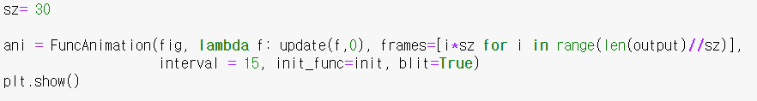
8 Planets

Slide 23
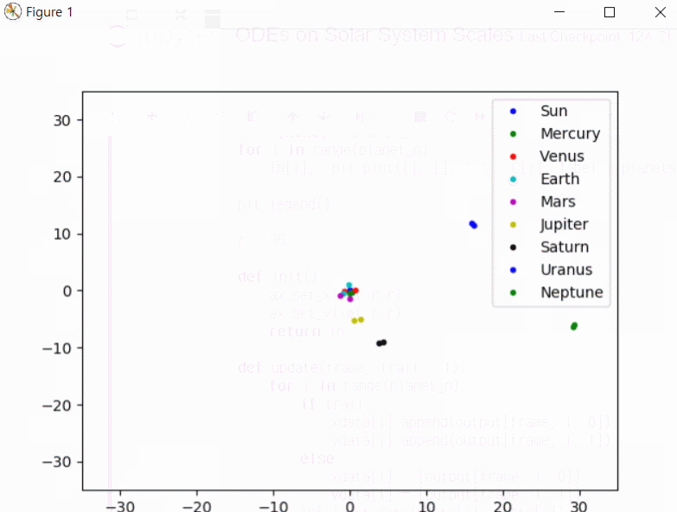
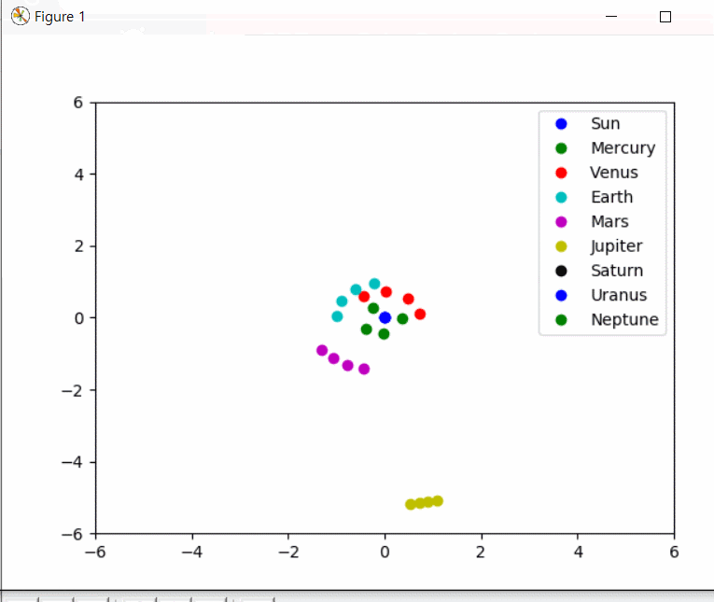
8 Planets

Slide 24
ODEs on Cosmology scales

Slide 25
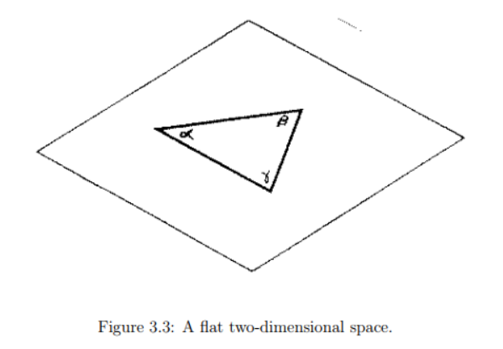
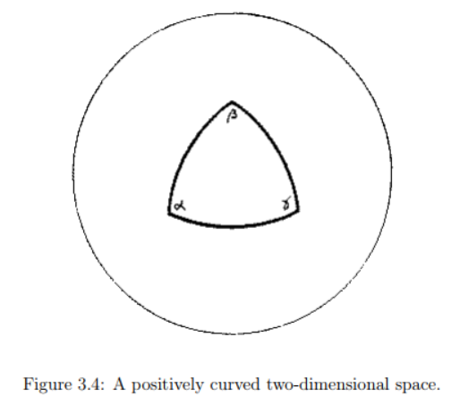
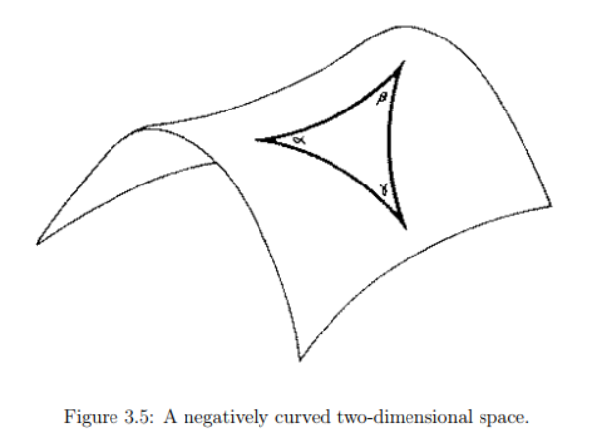
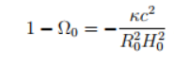
Curvature
Κ=0
Ω0=1
Κ=1
Ω0>1
Κ=-1
Ω0<1
Κ:curvature index=0 or 1 or -1
Ω0:density parameter=ε(t)/εc(t)

Slide 26



Friedmann Equation
Using the law of Universal Gravitation and Newton’s second law about the whole universe
Rs: Radius of our universe
a: Scale Factor
U: Total energy per unit mass

Slide 27



Acceleration Equation
Using First law of thermodynamics( ) considering our universe’s homogeneity and the relation of energy and energy density
ε: energy density
P: Pressure

Slide 28

Universes given density parameter

Slide 29

Universes given density parameter

Slide 30

Universes given density parameter

Slide 31

Expressing scale factor by time
For the following exercises, you may want to use time unites of $H_{0}^{−1}.$Write an ODE solver that takes I initial conditions: $a_{0}=a\left(t_{0}\right)$ and $H_{0}=\dot{\frac{a}{a}}$ and solves for $a\left(t\right)$ between $t_{i}{≤ t}_{0}≤t_{f}$. Check that your ODE solver gives you answers that agree with the solutions to question 1 => Find the general formula!

Slide 32

Expressing scale factor by time
Friedmann equation in python!
Runge Kutta from t0 to tf
Modified Runge Kutta from t0 to ti

Slide 33

Universes given density parameter

Slide 34

Universes given density parameter

